Slide 1

Receipt & Invoice Digitizer
Mentor: Dr.Santhiya Mam
Presented By: Pasula Nikhileshwar Reddy
Page
01

Slide 2


The Problem Statement
Manual extraction of text from receipt and invoice documents is slow and error-prone.
Therefore, a system is needed to upload receipt/invoice images, preprocess them for better clarity, and extract raw text using OCR to enable automated digitization.
Page
02

Slide 3
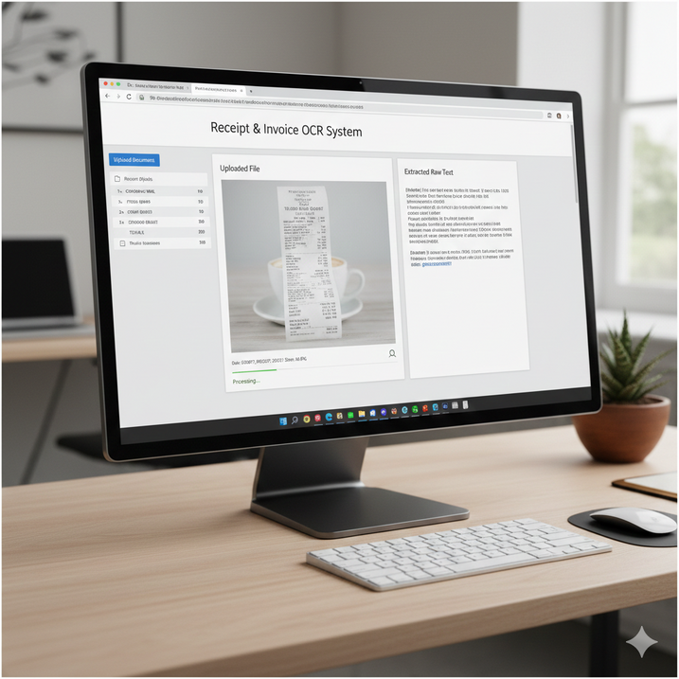

Objectives
Build a robust file upload system that allows users to upload receipt/invoice documents (JPG/PNG/JPEG/PDF) with proper validation of file format and size.
Implement image preprocessing techniques such as resizing, grayscale conversion, noise removal, and thresholding to enhance the clarity of the document and improve OCR accuracy.
Execute raw text extraction using OCR (Tesseract/EasyOCR) to convert the preprocessed receipt/invoice image into machine-readable text and display the extracted output for verification.
Page
03

Slide 4
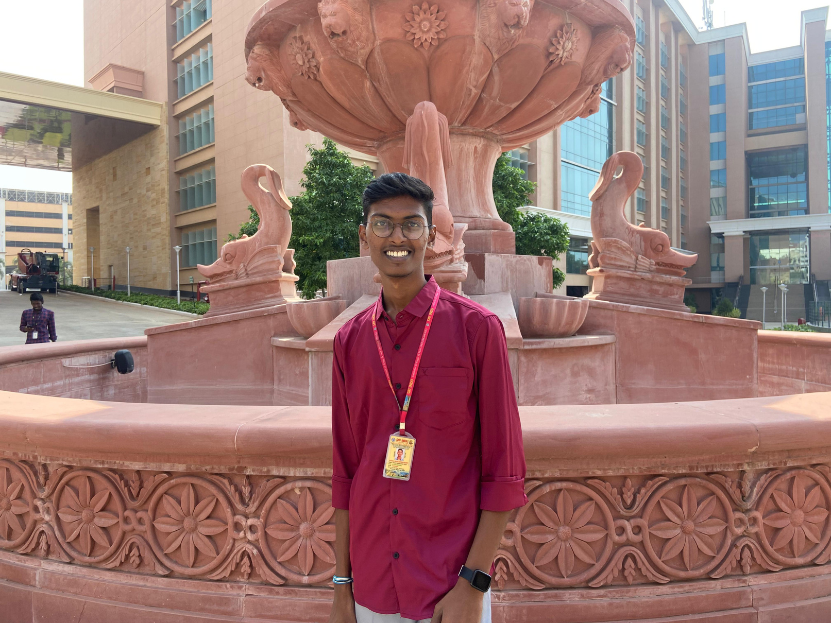
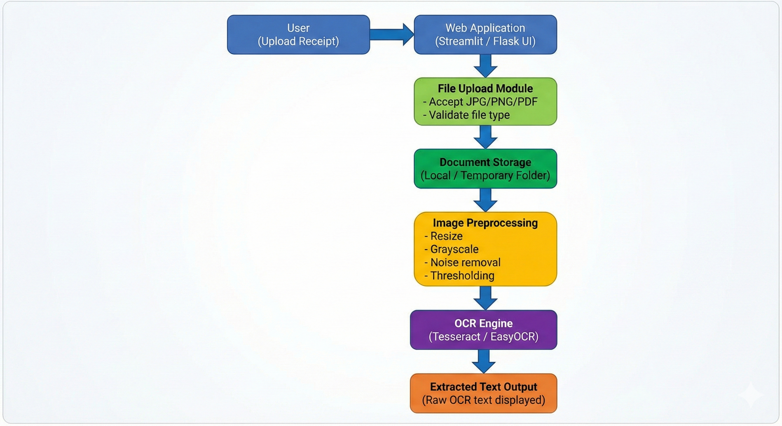
System Architechture
Page
04

Slide 5
System Architecture
The system architecture for Milestone–1 is designed as a simple and efficient pipeline to perform document ingestion and OCR.
The process begins when the user uploads a receipt or invoice document through the web interface. The uploaded file is then sent to the backend, where it is validated and stored temporarily in the system storage.
After successful storage, the document is passed to the OpenCV preprocessing module, which enhances the image by applying operations such as resizing, grayscale conversion, noise removal, and thresholding to improve text clarity.
The preprocessed image is then forwarded to the OCR engine (such as Tesseract/EasyOCR), which extracts the printed text and converts it into a raw string output. Finally, the extracted text is displayed to the user for review, forming the base for further structured extraction and digitization in upcoming milestones.
Page
05

Slide 6
OCR Implementation Strategy
The system uses Tesseract OCR to extract raw text from preprocessed receipt/invoice images. Before OCR, OpenCV preprocessing (grayscale, thresholding, denoising, resizing) is applied to improve text clarity.
To handle different fonts and layouts, the OCR will use suitable Tesseract configurations (PSM/OEM modes) and extract text line-by-line, ensuring better recognition across varying receipt formats, font styles, and structured/unstructured layouts.
Page
06

Slide 7
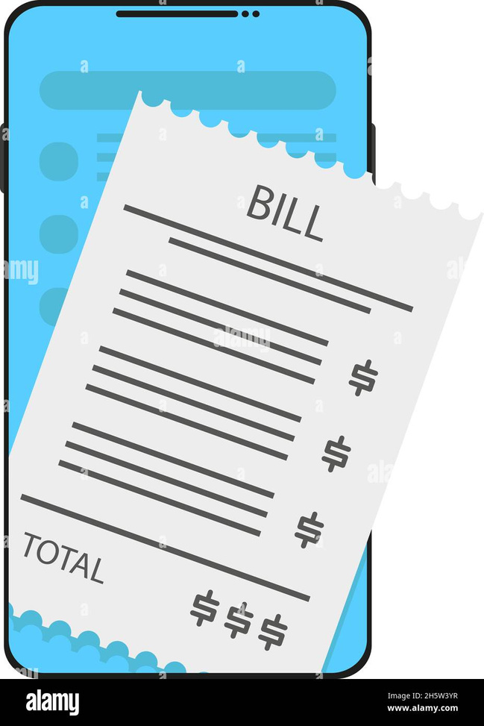
Evaluation & Validation
To verify the OCR system works correctly, the extracted OCR text will be compared with a manually prepared ground truth text file for the same receipt/invoice.
Accuracy will be measured using text matching/similarity metrics (like word-level accuracy or character-level similarity), and performance will be validated by testing multiple receipts with different layouts, fonts, and image quality.
Page
07

Slide 8
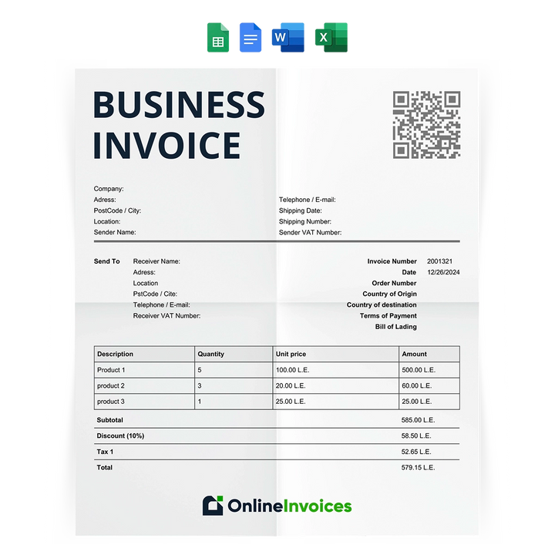
Conclusion
Milestone–1 successfully implements the core OCR pipeline by enabling file upload, applying image preprocessing, and extracting raw text from receipts/invoices.
This forms a strong foundation for future milestones like structured data extraction and storage.
Page
08

Slide 9

Thank
You.
Page
09

